Slide 1
Welcome to the Thunderdome.
Automating vCenter Patching
Alan Harrington
“Cu'z when its game time, it's pain time! Whoo!”
Terry Tate, Office Line Backer

Slide 2
Alan Harrington, Sr Lead Cloud Architect
RapidScale, Inc
VMware based cloud provider
VMware reseller
I see you in the audience
5 Domestic Datacenters, 3 International
Over 17k vms
IaaS, SD-WAN, DRaaS

Slide 3
Automating vCenter Patching
Discussion Points
vCenter Sprawl
vCenter Security
Patching best practices
29? vCenters
Manual Staging
Some Lesser known Settings
New PowerCli Commandlets
Broadcom / VMware neutral

Slide 4
VMware vCenter
1. Centralized Management: VMware vCenter Server is a server management utility that allows for the centralized management of VMware vSphere environments, enabling efficient handling of infrastructure from a single point of control.
2. Scalability and Deployment Options: It supports large-scale management of VMware virtual environments and offers multiple deployment options, including on-premises and as a cloud service, providing flexibility depending on organizational needs.
3. Enhanced Visibility and Control: vCenter provides administrators with deep visibility into the health and status of all virtual machines, hosts, and other critical components through a unified interface. It includes performance charts, alarms, and event management tools to help maintain the health and performance of the infrastructure.
4. Extensive Feature Set: It enables features such as vMotion (live migration of virtual machines), High Availability (HA), Distributed Resource Scheduler (DRS), and more, which help in improving the resilience, performance, and resource utilization of virtual environments.
5. Security and Compliance: vCenter Server facilitates comprehensive security measures including role-based access control, authentication mechanisms, and activity logging, helping organizations meet various compliance requirements efficiently.

Slide 5
Patching Best Practices
Destroy vCenter HA
REVIEW HCL and Third Party Apps (Veeam, Zerto, Synology, NSX, etc)
Patch in stages (Every one says they do this)
Development
Testing
Production
Patch on a Tuesday or Wednesday
Mondays are for catchup
Read Only Friday
Thursday is little Friday
VMware previously has shown that unless it’s a critical security patch, it’s probably best to wait a week or two before rolling to production.

Slide 6
vCenter as a hacker’s favorite target
VMware vCenter is a critical component of many IT infrastructures, making it an attractive target for hackers. Here are five reasons why hackers might target vCenter and why it's crucial to keep it patched:
Centralized Control: vCenter offers centralized management of all virtual machines and hosts in a VMware environment. Gaining unauthorized access to vCenter can give hackers control over the entire virtual infrastructure, allowing them to manipulate or disrupt operations significantly.
Access to Sensitive Data: vCenter servers often have access to a vast amount of sensitive data across the network. Compromising vCenter can potentially allow hackers to access confidential information, including personal data, intellectual property, and business-critical data stored on virtual machines.
Privilege Escalation: By exploiting vulnerabilities in vCenter, attackers can escalate their privileges within the network. This could enable them to execute commands with administrative privileges, deploy malicious software, and create backdoors for future access.
Spread of Malware: Once vCenter is compromised, it becomes easier for attackers to spread malware across the network to multiple virtual machines. This can lead to widespread damage, data breaches, and persistent security threats within the organization.
Disruption of Critical Operations: Hackers may target vCenter to disrupt critical operations, especially in industries like healthcare, finance, and public services. Such disruptions can lead to significant financial losses, damage to reputation, and legal consequences.

Slide 7
Importance of regularly patching vCenter
Security Enhancements:
Regular patches often include fixes for known vulnerabilities that could be exploited by hackers. By keeping vCenter updated, you close these security gaps and reduce the risk of cyberattacks.
Bug Fixes:
Patches frequently address numerous bugs that can affect the performance and functionality of vCenter. These bug fixes are critical as they resolve issues that could cause system instability, incorrect functionality, or user interface problems, ensuring that vCenter operates smoothly and efficiently.
Compliance:
Many regulatory standards require that software be kept up-to-date as part of compliance requirements. Regularly patching vCenter helps ensure compliance with these standards, avoiding legal and financial penalties.
Prevent Exploitation of Zero-day Vulnerabilities:
Timely application of patches can protect against zero-day attacks, where vulnerabilities are exploited before they are widely known or patched. This proactive approach to security is vital for maintaining the integrity of your IT infrastructure.
Maintaining Trust and Reliability:
Keeping systems patched and secure enhances the trust stakeholders place in an organization's IT operations. It can safeguard the organization's reputation from damage due to security breaches and demonstrate a commitment to operational excellence and reliability.

Slide 8
vCenter Sprawl
Different applications / Platforms require separate vCenters
NSX-V
NSX
Horizon DaaS
VCF – Management
VCF – Workload Domains
Private Clouds / Compliance
It’s easy to see how you can have 5-10 vCenters per physical datacenter due to different requirements.

Slide 9
vCenter 8.0 U2 Reduced Downtime Upgrade
vCenter Reduced Downtime Update (RDU) in vSphere 8 U2 represents a significant improvement in updating and patching VMware environments by minimizing downtime during vCenter upgrades. It's designed to enhance the efficiency of maintenance processes, which is particularly useful for large-scale deployments where minimizing service interruptions is critical.
How RDU Works:
RDU employs a migration-based approach, where a new vCenter instance is set up and configuration data is transferred from the existing to the new instance while the original vCenter remains operational. This process allows for continuous operation until the final switchover, which typically takes less than five minutes. The primary improvement over traditional methods is that most of the heavy lifting, including data transfer and configuration, is done without impacting the operational uptime of vCenter.
Benefits:
Reduced Downtime: The most notable benefit is the significant reduction in downtime, as the system remains operational during the upgrade process until the very last step of the switchover.
Streamlined Process: By automating and integrating the upgrade process within the vSphere environment, RDU simplifies the upgrade process, making it less prone to human error.
Caveats and Limitations:
However, while RDU marks a step forward, there are notable limitations:
Initial Setup Complexity: Setting up RDU involves a precise configuration, including updating the vCenter Lifecycle Manager service plugin to manage the upgrade, which adds initial complexity.
Limited Scope of Support: Currently, RDU is only supported for single, self-managed vCenter instances (NO VCF). It does not support instances with vCenter HA or those participating in Enhanced Linked Mode, which could limit its applicability in more complex environments.
Requirement for Temporary Resources: The new vCenter requires a temporary IP address for the process, extra storage, necessitating additional networking configurations which might not be straightforward in all environments.
No Scripting support (that I know of)
Conclusion:
While RDU in vSphere 8 U2 is undoubtedly a step in the right direction, especially for environments where uptime is critical, it still comes with limitations that might not make it a one-size-fits-all solution. Organizations will need to assess their specific needs and constraints, particularly regarding vCenter architecture and network configurations, to determine if RDU is a viable option for their vSphere environment updates.

Slide 10
So what to do about it?

Slide 11
Some Security Scripting Best Practices
When it comes to scripting, especially in environments where scripts handle sensitive operations or data access, it's crucial to follow security best practices for managing passwords. Here are five best practices for scripting security regarding password management:
Avoid Hardcoding Passwords:
Never embed plaintext passwords directly in scripts. Hardcoding passwords can lead to significant security vulnerabilities, as the scripts can be accessed or exposed during version control, backups, or by unauthorized personnel.
Use Secure Storage Solutions:
Store passwords and other sensitive credentials in secure storage solutions like vaults (e.g., HashiCorp Vault, Azure Key Vault, or Microsoft.PowerShell.SecretStore). These tools provide encryption, access controls, and auditing capabilities, ensuring that credentials are protected and only accessible to authorized scripts and users.
Implement Least Privilege Access:
Ensure that credentials used in scripts have the minimum necessary permissions for the task. This reduces the impact of any potential exposure or misuse of those credentials. Regularly review and adjust permissions in line with security policies.
Regularly Rotate Credentials:
Regularly change passwords and other credentials used in scripts to limit the window of opportunity for any exposed credentials to be misused. Automate this process if possible, and ensure scripts can handle dynamic retrieval of updated credentials without manual intervention.
Secure Transmission of Credentials:
Always use encrypted channels (such as HTTPS, SSH, or TLS) for transmitting sensitive information, including credentials, to prevent interception by unauthorized parties. Avoid passing sensitive information through insecure methods such as plain text logs or unsecured network protocols.
By implementing these best practices, you can significantly enhance the security of your scripts and protect sensitive data from unauthorized access and potential security breaches.

Slide 12
My personal favorite: Microsoft.PowerShell.SecretStore
Why? Because CrowdStrike showed me how to use it
Using Microsoft.PowerShell.SecretStore to manage credentials in PowerShell scripts offers several significant security benefits over hardcoding credentials directly into scripts. Here’s an overview of the key advantages:
1. Secured Storage of Credentials
Microsoft.PowerShell.SecretStore provides a secure vault where credentials and other sensitive information are stored encrypted. This vault is protected by encryption algorithms designed to safeguard the data from unauthorized access. When you use the SecretStore, you ensure that sensitive data like passwords, API keys, or connection strings are not exposed in plain text.
2. Reduce Risk of Credential Leakage
Hardcoding credentials in scripts can lead to accidental exposure. For example, if the script is shared, stored in version control, or accessed by unauthorized persons, those credentials can be compromised. By using SecretStore, credentials are never exposed in the script’s code, reducing the risk of credential leakage.
3. Central Management of Secrets
SecretStore allows for centralized management of secrets. This means you can update, manage, and rotate credentials without having to modify each script individually. It simplifies management especially when scripts are deployed across different environments or systems.
4. Auditing and Access Controls
The SecretStore module can be configured to provide auditing capabilities, allowing administrators to track access to the secrets and identify which scripts are accessing specific credentials. Furthermore, access controls can be enforced to restrict who can retrieve or manage these secrets, ensuring that only authorized scripts and users have access.
5. Simplify Credential Changes
When credentials need to be changed, updating them in a SecretStore does not require changes to the script code itself. This decoupling of credentials from the scripts not only makes it easier to maintain and update scripts but also speeds up the process of credential rotation which is a best practice in secure environments.
6. Compliance with Security Policies
Using a secret management tool like Microsoft.PowerShell.SecretStore helps organizations comply with security policies and regulatory requirements that mandate the protection of sensitive information. Hardcoding credentials often violates these policies, whereas using a secure storage mechanism for credentials aligns with best practices for data protection.

Slide 13
Quick Example:
# Install the Microsoft.PowerShell.SecretStore module from the PowerShell Gallery.
Install-Module Microsoft.PowerShell.SecretStore
# Register a new secret vault named 'svc_vCenter_Creds' using the Microsoft.PowerShell.SecretStore module.
# Note, This vault is NOT set as the default, so we will need to call it each time, and then below makes it so interact with the vault with scripts
Register-SecretVault -Name 'svc_vCenter_Creds' -ModuleName Microsoft.PowerShell.SecretStore Set-SecretStoreConfiguration -Authentication Password -Interaction None -Confirm:$false
# Prompt the user to enter credentials, which are then stored securely in 'svc_vCenter_Creds' under the name 'svc_vmware@hahanovsphere.local'.
# The Get-Credential cmdlet opens a prompt for username and password, which are stored as a PSCredential object.
Set-Secret -Name 'svc_vmware@hahanovsphere.local' -Secret (Get-Credential) -Vault 'svc_vCenter_Creds'
# Retrieve the credentials stored under 'svc_vmware@hahanovsphere.local' from 'svc_vCenter_Creds'.
# The credentials are stored in the variable $tempcreds.
$tempcreds = Get-Secret -Name 'svc_vmware@hahanovsphere.local' -Vault 'svc_vCenter_Creds'
# Connect to the vCenter server named 'vCenter-test02' using the credentials retrieved from the secret vault.
# The username and password are extracted from the $tempcreds object, which holds a PSCredential.
connect-viserver -server "vCenter-test02" -User $tempcreds.Username -Password $tempcreds.GetNetworkCredential().Password
# Clear the credentials from memory by setting $tempcreds to $null, enhancing security by removing sensitive data from the session.
$tempcreds = $null

Slide 14
So what to do about it?

Slide 15
Comma Separated Values in vCentersToUpdate.csv
vCenterFQDN,CredentialKey
rossi.vcenter.com,cred_rossi123
marquez.vcenter.com,cred_marquez456
lorenzo.vcenter.com,cred_lorenzo789
stoner.vcenter.com,cred_stoner101
pedrosa.vcenter.com,cred_pedrosa202
biaggi.vcenter.com,cred_biaggi303
doohan.vcenter.com,cred_doohan404
rainey.vcenter.com,cred_rainey505
gardner.vcenter.com,cred_gardner606
schwantz.vcenter.com,cred_schwantz707
hayden.vcenter.com,cred_hayden808
simoncelli.vcenter.com,cred_simoncelli909
spies.vcenter.com,cred_spies010
agostini.vcenter.com,cred_agostini111
hailwood.vcenter.com,cred_hailwood212

Slide 16
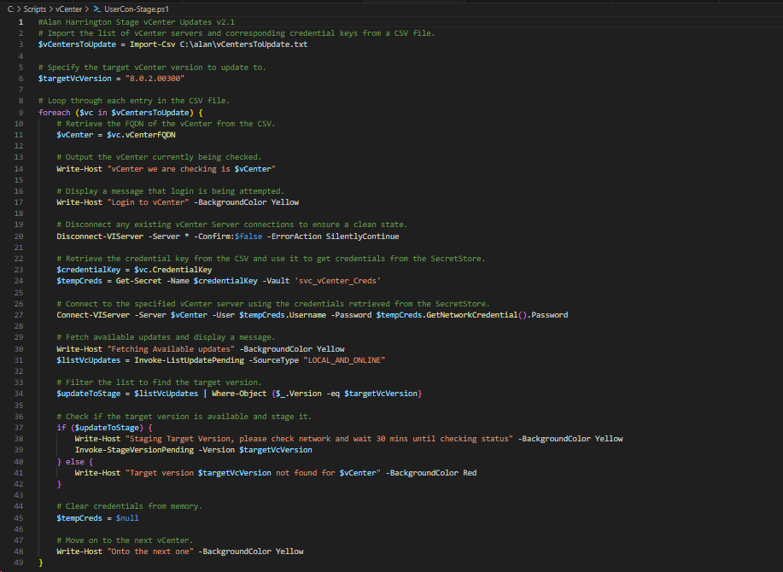
Staging The Night Before

Slide 17
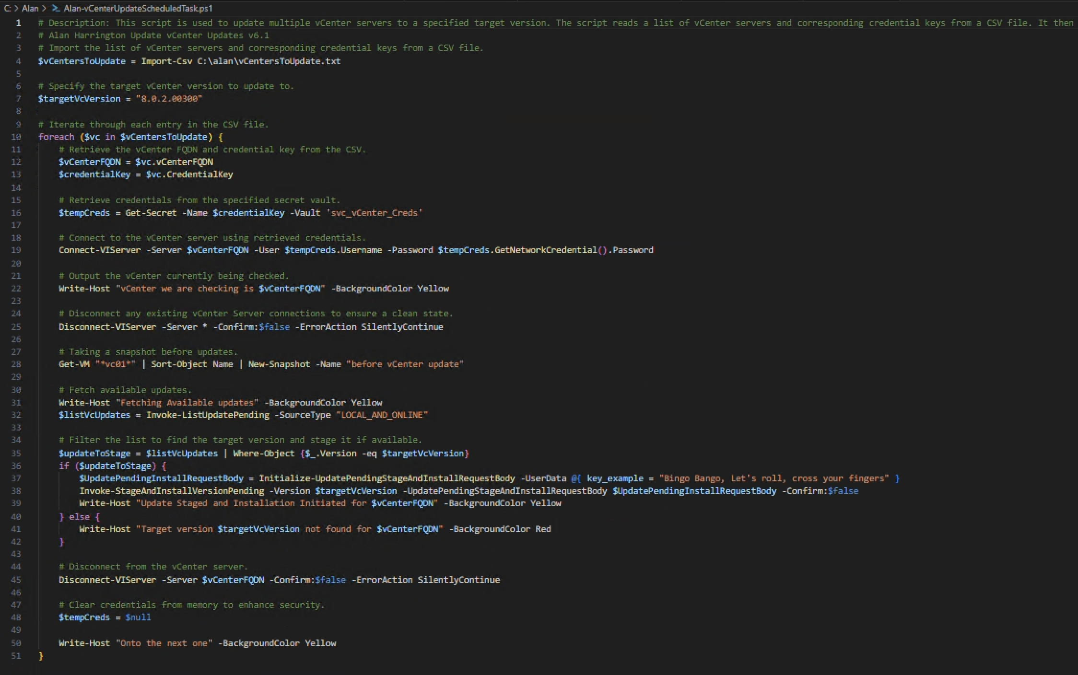
And Then???

Slide 18
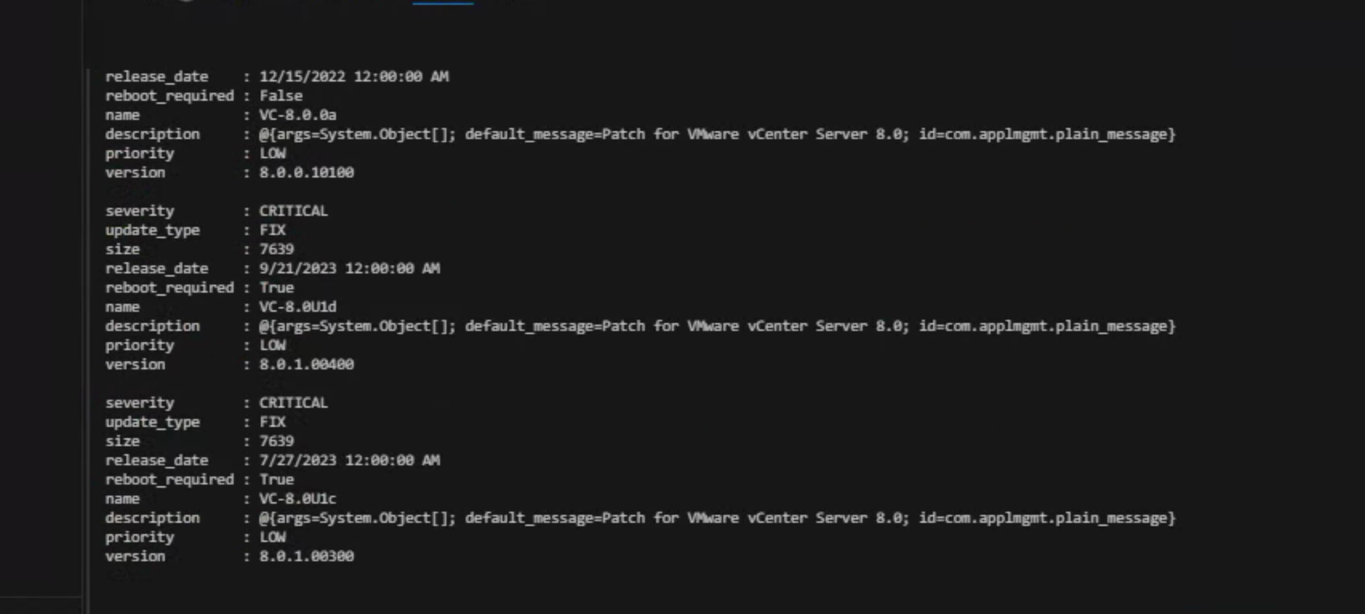
Versions

Slide 19
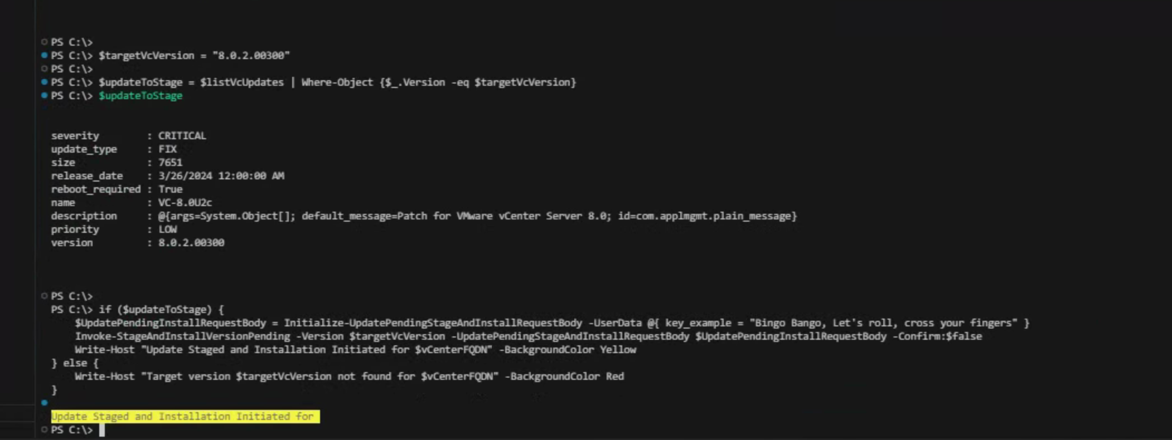
Install

Slide 20
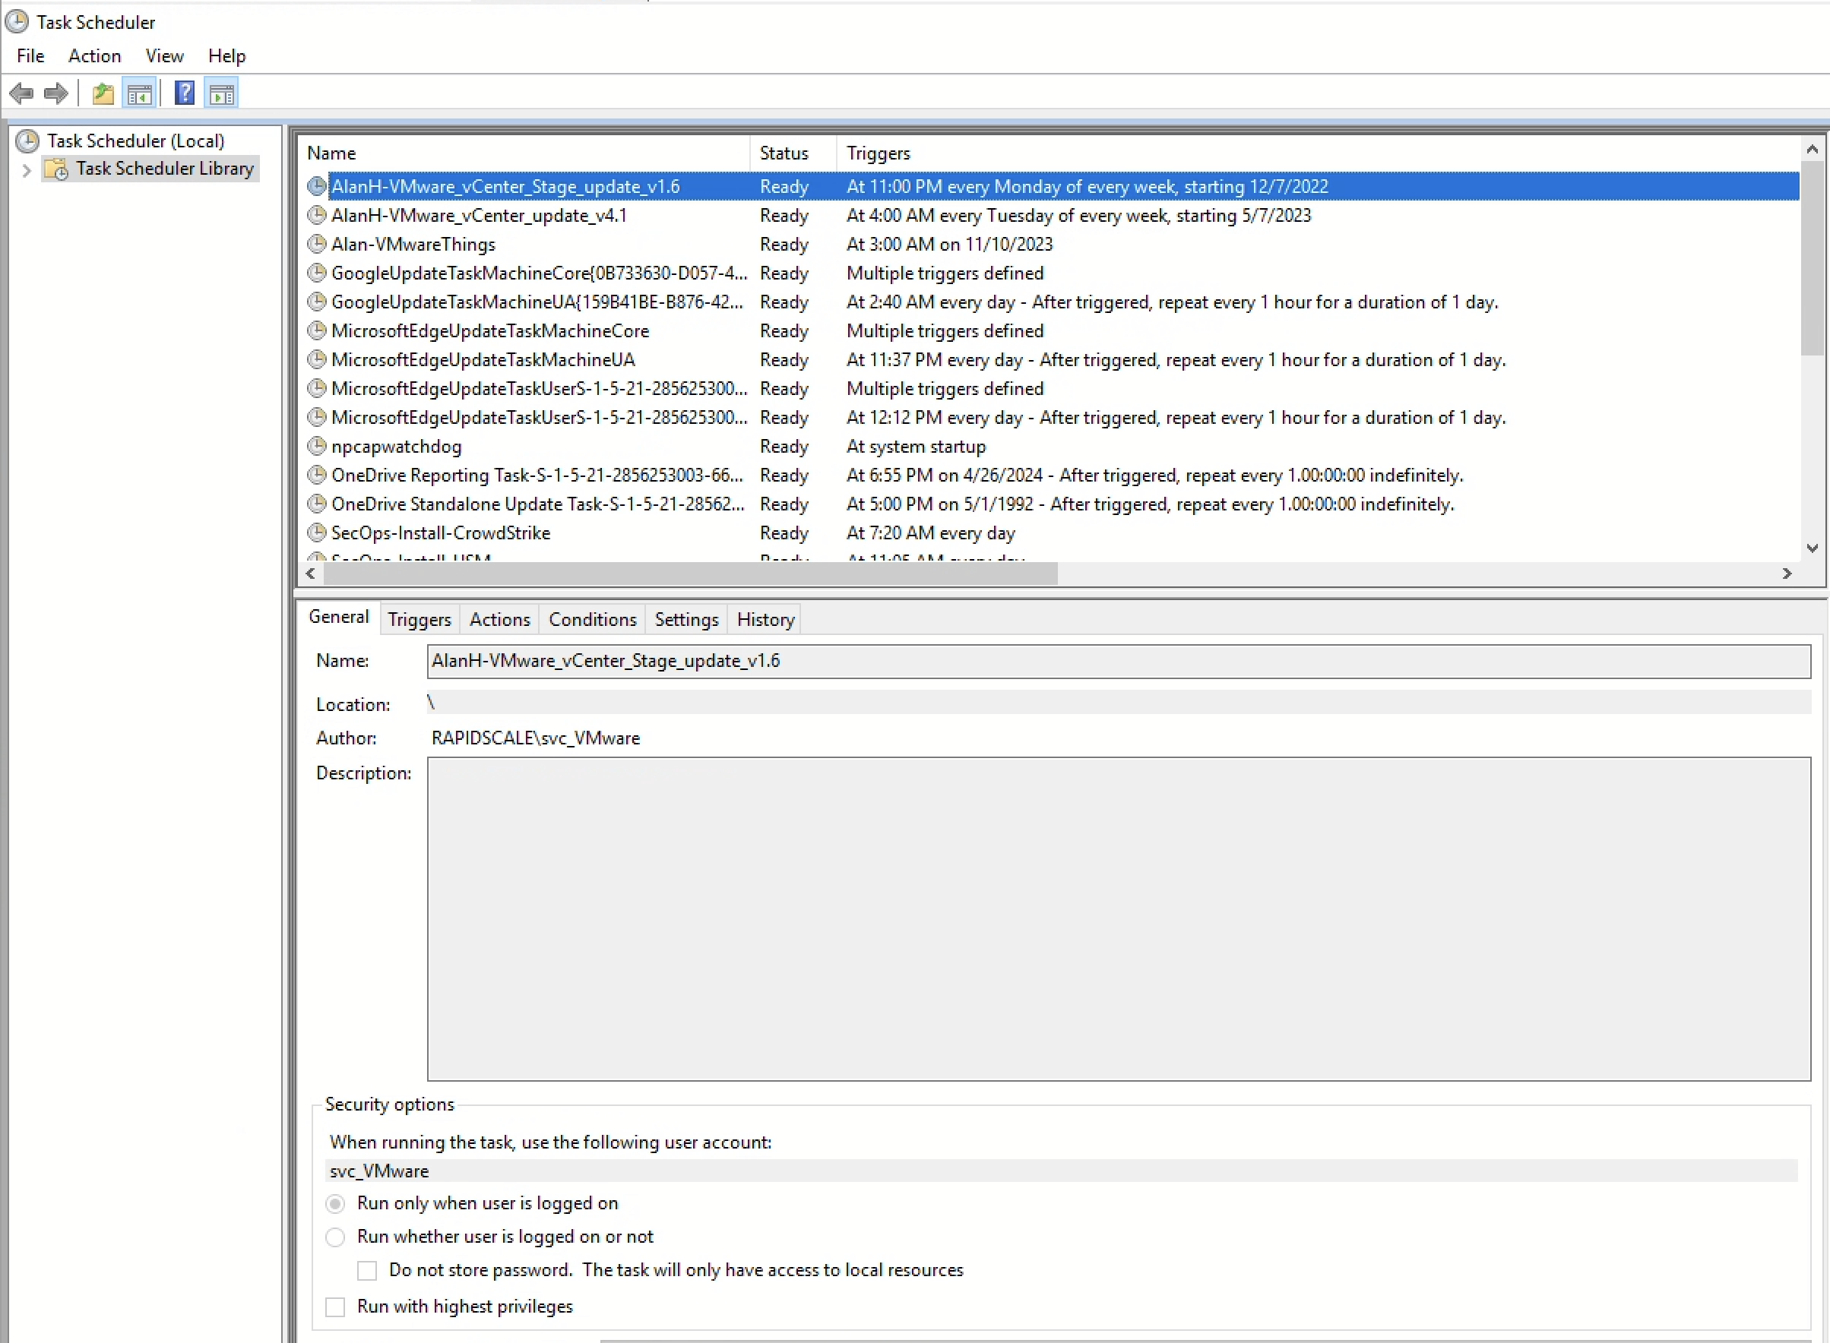
Scheduled Task
Run as the same service account for the secret store, call PowerShell script.

Slide 21
Lack of video example
Because it would take a lot of time
Not much to see
Pretty Boring

Slide 22
In Progress things:
Watching the logs from vCenter patching
After certain time reconnecting to vCenter to validate successful upgrade
If not successful and vCenter down after certain time revert snap and boot
Parallelization of Updates (instead of for each)
Emailing Updates
Making CSV include vCenter Target version
Destroying and Re Creating vCenter HA

Slide 23
Lesser Known Settings and Official VMware Commandlets

Slide 24

VMware Repo
Interesting and helpful commands listed in here
https://www.powershellgallery.com/packages/VMware.Sdk.vSphere.Appliance.Update/8.0.1669.22649494

Slide 25
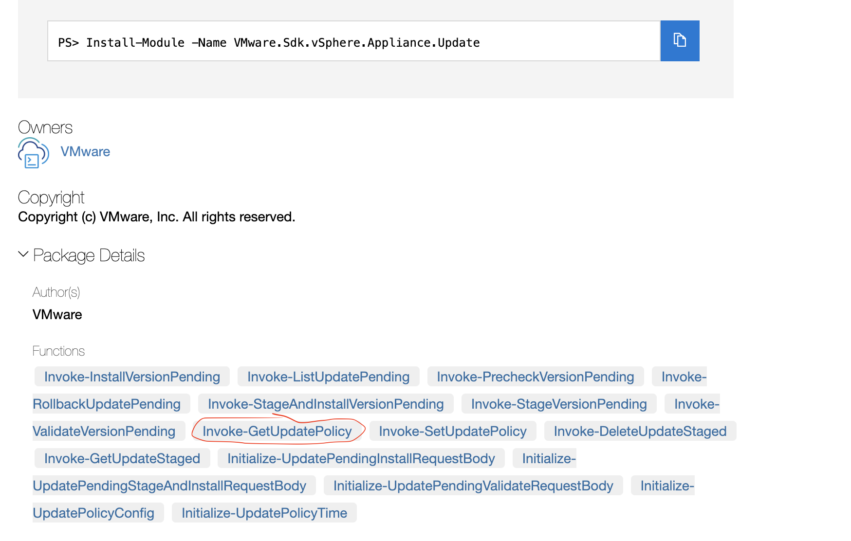
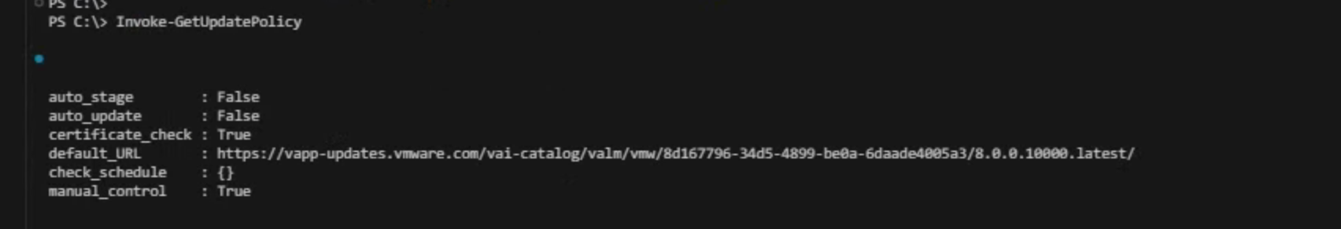
Curious…

Slide 26
Things we can do.
Seems to be not well known without much examples
Automatically Stage the latest Update (to note, if it’s not installed, and a new update comes out, it’ll fail)
Set the Check schedule (can do from gui)
Automatically Update to the latest Update (sounds scary)

Slide 27
Thank you for coming!

Slide 28

https://github.com/alan-harrington/AlanPublic
Yeah… It’s Empty right now, waiting on approval to release everything, should know by 5/3/2024 (yes, last Friday)
Any questions?

Slide 30


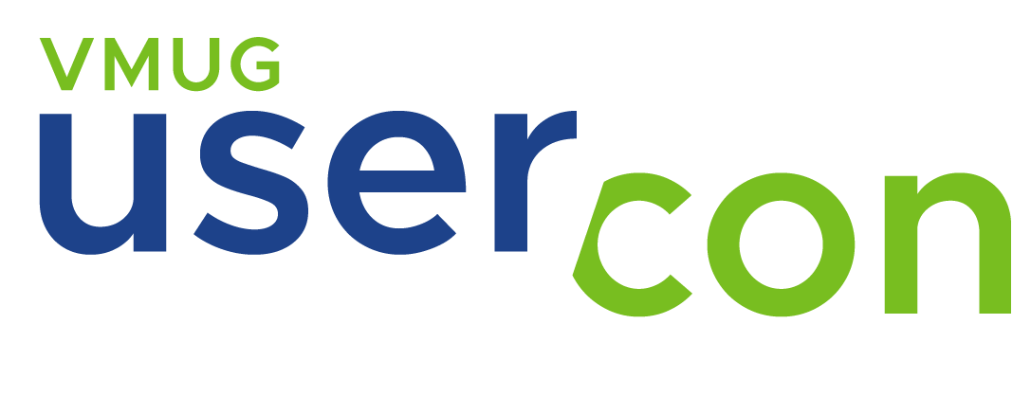




Alan Harrington

